Slide 1
Writing Award Winning PowerShell
Functions and Script Modules

Slide 2

Get-Help –Name ‘about_Presenter’
Mike F Robbins
Microsoft MVP on Windows PowerShell
Leader & Co-Founder of Mississippi PowerShell User Group
Author of PowerShell 101: The No-Nonsense Beginner’s Guide
Co-Author of Windows PowerShell TFM 4th Edition
Author of Chapter 6 in the PowerShell Deep Dives book
Winner of the Advanced Category in the 2013 Scripting Games
Learn more about me @ mikefrobbins.com

Slide 3
Write-Output ‘Questions for Audience’
IT Pro’s
Developers
Managers
Functions
Modules
Unit Testing
Source Control
Experts

Slide 4

Quick & Dirty Code 6 Months Later

Slide 5
Set-Content ‘Information to Cover’
Best Practices
Parameters
Parameter Validation
CmdletBinding
SupportsShouldProcess
Pipeline Input
Error Handling
Module Manifest
Custom Formatting
And More ☺

Slide 6

Great Code 6 Months Later

Slide 7
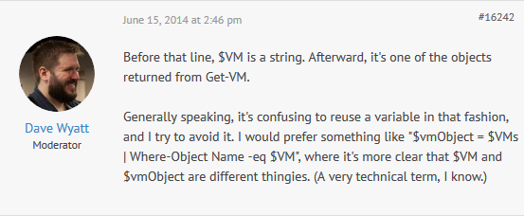
Don’t Reuse Variable Names
Source: https://powershell.org/forums/topic/redundancy-of-code-in-advanced-function/

Slide 8
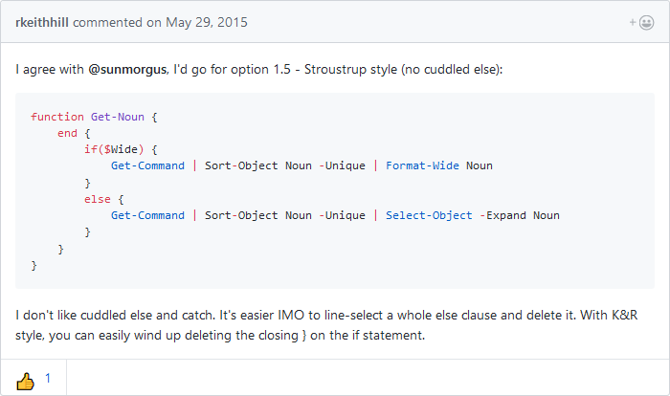
Where to put braces?
Source: https://github.com/PoshCode/PowerShellPracticeAndStyle/issues/24#issuecomment-106860973

Slide 9

Start-Process ‘Demo’
Demo Code: github.com/mikefrobbins/Presentations

Slide 10
Select-Object –Property ‘Resources’
PowerShell Documentation
PowerShell Best Practices and Style Guide
Microsoft Virtual Academy
PowerShell.org
GitHub
User Groups
Blogs
Twitter
Slack

Slide 11

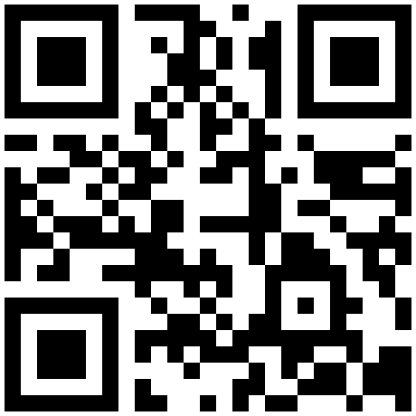


Get-Contact –Identity ‘Presenter’
Blog: mikefrobbins.com (or MrPowerShell.com)
Twitter: @mikefrobbins
LinkedIn: www.linkedin.com/in/mikefrobbins
E-Mail: See mikefrobbins.com/about/
User Group: mspsug.com (or MsPowerShell.com)

